Slide 1
Cyber Resilience
and
Board Involvement
A different approach
Bright G. Mawudor, PhD:
www.brightzeed.com

Slide 2


“No one thinks they are going to
be a victim of a Cyber Attack Until it happens to THEM”
Notes:
[CLICK TO NEXT SLIDE]

Slide 3
Cyber Security Breach Statistics
Breaches take a median length of 86 days to be detected,
and 111 days from intrusion to containment
27% of organizations encountered a CEO fraud attack in the past 12 months.
74% of cybersecurity professionals say their organization has been impacted by the global cybersecurity skills shortage.
In both cloud and POS environments, 60% of breach investigations can attribute successful social engineering as the conduit to initial point of entry

Slide 4
When Does The Board Get Involved
The Board & Senior Management
Usually Want To Only Get Involved When:
Security Breach Has Occurred
Reputational Damage Is On The Line
Financial Lost Has Been Triggered
Total Lockdown Of Systems And Network

Slide 5
Board Level Awareness
How do we demonstrate the return on investment of our Cyber Security measures
When was the Cyber threat last examined by the Board
03
04
How do we put the Cyber threats we face into business context
02
IDEA
05
Is Cyber part of the Boards Strategy discussion
How do we move from reactive to anticipating Cyber Attacks
01
06
Does our CIO know when to act and are they empowered to do so? Has it been effective?
Notes:
So there needs to be a new approach.
Today’s threats are outpacing traditional risk management measures. In the old model, you can be right most of the time but adversaries only need to be right once to breach your defences.
On the other hand, you only need to detect them once to identify their activities and perform a course of action to mitigate their attempts.
Predictive threat intelligence is all about a proactive and predictive model to identify threats early on, before it is materially realised, minimising impact and reducing risk exposure.
Clients are seeking our assistance to accelerate their security capabilities and maturity using an intelligence-led approach. They simply can no longer afford to respond after the fact, and choose to take a preventative stance.

Slide 6
Boardroom Questions
What processes do we have in place to deal with Cyber Threats?
Who in our organization is responsible for Cyber Security issues?
08
01
Do we meet the information security requirements to bid for government contracts?
What are our Key information Assets?
07
02
SERVICE
Does our organization meet all of its obligations for information assurance?
06
03
Do we fully understand our current vulnerabilities?
05
04
Do any of our supply chain partners put us at risk?
What is our risk appetite?
Notes:
So there needs to be a new approach.
Today’s threats are outpacing traditional risk management measures. In the old model, you can be right most of the time but adversaries only need to be right once to breach your defences.
On the other hand, you only need to detect them once to identify their activities and perform a course of action to mitigate their attempts.
Predictive threat intelligence is all about a proactive and predictive model to identify threats early on, before it is materially realised, minimising impact and reducing risk exposure.
Clients are seeking our assistance to accelerate their security capabilities and maturity using an intelligence-led approach. They simply can no longer afford to respond after the fact, and choose to take a preventative stance.

Slide 7

Live Hacking Demo

Slide 8
The Mind Shift - Designing for Failure
THEN
NOW
Reliability: Designed not to fail
Resilience: Designed to recover quickly
Prevent: Every possible attack
Assume Compromise: Protect, detect, and respond along attack phases
!
!
!
!
!
!
Notes:
Key Takeaway: Organization leaders can help set the tone that security is about business risk management and is not a technical problem that can be ‘solved’
With the adoption of cloud technology, Information Technology is assuming failure and shifting from a reliability mindset (reduce mean-time-between-failures (MTBF)) to a resilient mindset (reduce mean-time-to-recover (MTTR))
To this end, a resilient cloud service:
- minimizes the impact of failure on any given customer,
- minimizes the number of customers affected by a failure
- reduces the amount of time customers are prevented from using the service in its entirety.
CLICK 1
Security should adopt a similar posture in the age of continuous and evolving attacks.
We can no longer block every possible attack at a firewall that stands between our assets and the threats. We must assume compromise and invest in protections and detections at each phase of an attack (frequently called a kill chain). The overall architecture and each asset in it should be resilient to a compromise.

Slide 9
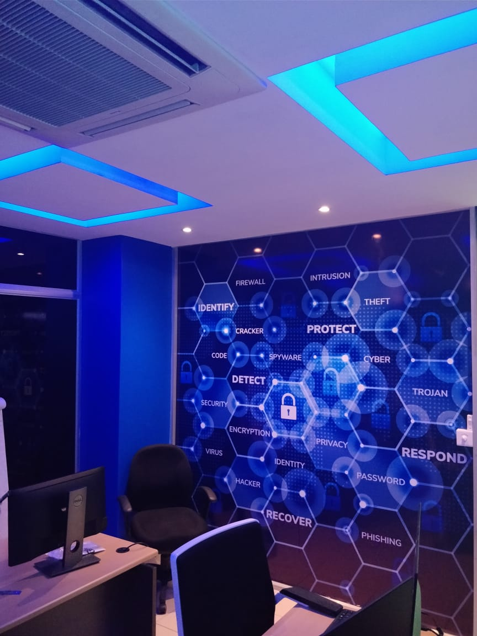
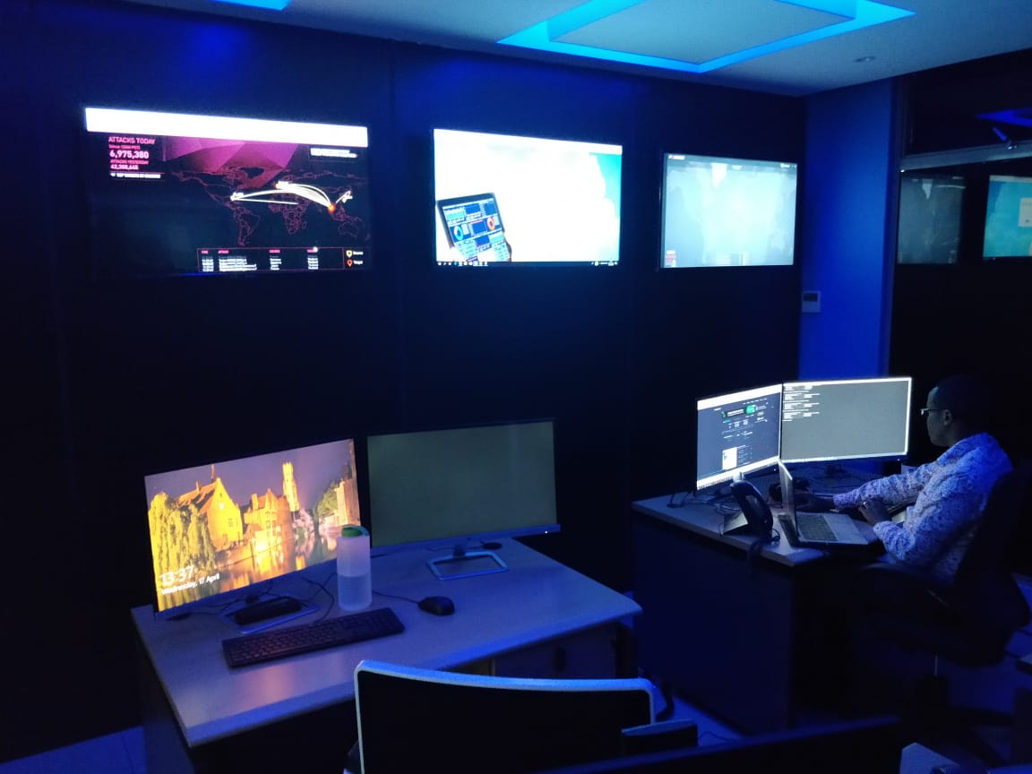
Threat Intelligence Centre

Slide 10

Thank you

