Slide 1

FSD Africa collaboration with APSA
July 2024
Notes:
Title of slide
1

Slide 2
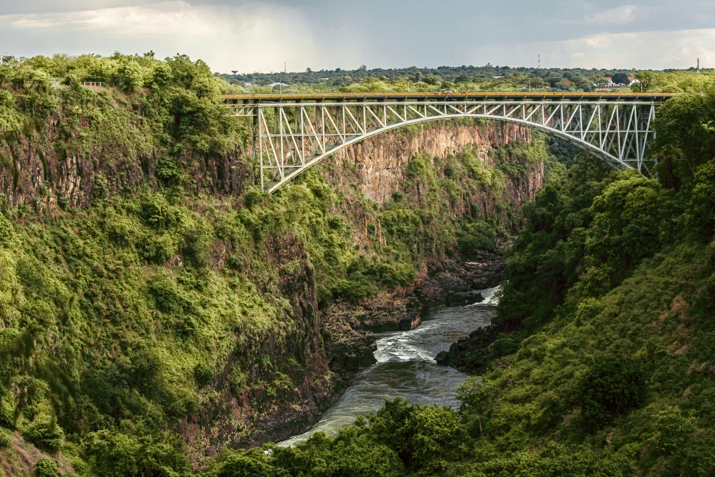
Content
Listed SME Intermediated Debt Fund
FSD Africa collaboration with APSA
About FSD Africa
Context of APSA
The Landscape Of Pensions In Africa
Contribution to Economic Development
FSD Africa Supported Initiatives
Collaboration with PAFMA
Call to Action

Slide 3
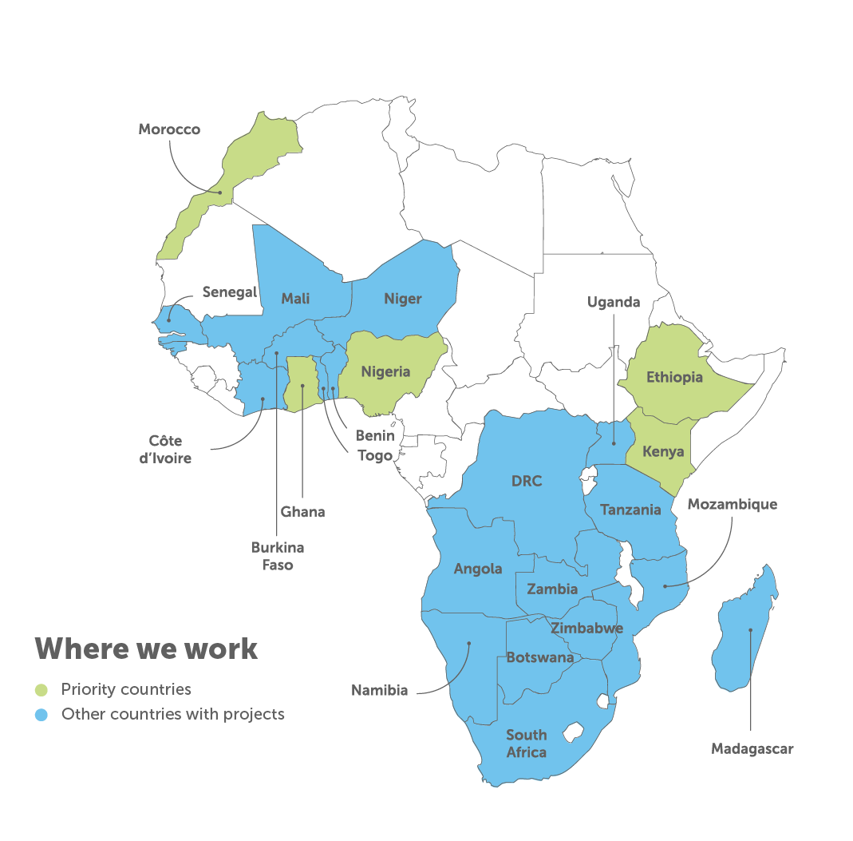





Capital Markets Approach – reinforcing support for market development
FSD Africa collaboration with APSA
FSD Africa is a specialist development agency working to strengthen financial markets in Africa.
We work in over 30 African countries to mobilise “green plus” finance that will power economic and social development while delivering environmental gains and building Africa’s resilience.
Thematic areas: Risk & Resilience (plus Nature), Early-Stage Finance (plus Carbon Markets) and Capital Markets
How we work
Grants and
Data and knowledge
returnable grants
management
FSD Africa invests in research, analysis and intelligence-gathering initiatives that give financial sector stakeholders access to market data and knowledge so they can make better investment decisions and manage risk more effectively.
We provide grants without the expectation of a financial return where a business is high potential but high risk. We also give grants to non-commercial projects with the potential for system-wide impact.
Investment
Technical
Networks and
capital
assistance
partnerships
We finance high-risk businesses and funds operating in the financial sector that have the potential for high impact in financing green initiatives and are able to utiiise a variety of different transaction structures including loans, guarantees and equity or quasi-equity.
We provide advisory services and technical support to the public and private sectors. We collaborate with financial sector experts and co-design with partners technical assistance initiatives and capacity-building support programmes.
We have a wide and growing network of national, regional and international stakeholders to crowdfund, pool ideas and share risk, while expanding reach and building sustainability.

Slide 4
Capital Markets Approach – reinforcing support for market development
FSD Africa collaboration with APSA
We develop Africa’s capital markets to increase the availability of long-term finance for economic development - with the aim of sparking large-scale and long-term change
Policy, regulations, incentives
- Reforms to reduce cost of capital, complexity, speed of approvals
- Thematic bonds guidelines and incentives (e.g. taxes)
- Stewardship codes & ESG investment guidelines
Market Infrastructure
- Credit enhancement and risk-sharing facilities
- Bond exchanges (improve liquidity, reduce transaction costs, esp. for thematic bonds)
Products/Transactions
-Thematic bonds development (e.g. green, sustainability-linked), carbon-linked bonds; fund structures (private & listed); pooled vehicles & green securitizations
Partnerships & Capacity Building
- Co-investment/consortium opportunities
- Toolkits: Green bonds, Gender Bonds, Islamic Finance
Climate Finance Training
Sustainable Capital Markets Development’
Enabling Environment
Transactions Support
Practical Training
Market Infrastructure

Slide 5
Our Footprint
Implementing over 60 projects in 33 countries across Africa
FSD Africa collaboration with APSA
Product Development
Green Bonds; Gender Bonds; Islamic Finance; Green SME Listed Funds; Private Equity & Debt, CISs; REITs; Debt for Nature Swaps; Carbon-Secured Sustainability-Linked Bonds; Local Currency Solution for MDB Portfolio Transfer
Capacity building
AVCA Academy, Climate Finance Training (ESAMI, IIED & CISL)
Market
infrastructure
EABX; ESX, CSD (Ethiopia); Frontclear; WAEMU ETP; Credit Enhancement Facilities (DGCo)
Institutional & Regulatory
support
Africa Pension Supervisors Association (APSA), PAFMA, ARSP I&II; Ghana Sovereign Debt Advisory
Toolkits: Islamic Finance; Green Bonds; Gender Bonds; PE; IOSCO Listings Report; Research on Fiscal Consequences of COVID 19.
FCDO Priority countries
Thought Leadership
Other countries with projects

Slide 6
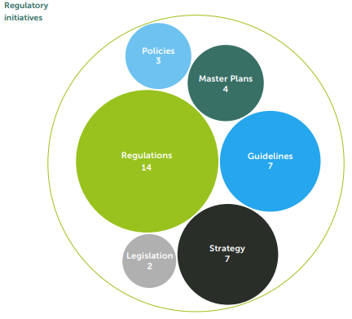

FSD Africa’s key Capital Markets achievements
FSD Africa collaboration with APSA
Regulatory Initiatives
Groundbreaking Transactions Supported by FSD Africa – US$1.2 bn
Morocco
1st gender bond in Africa
1st green mobility bond
Kenya
Dhamana Guarantee Company
EABX – Bond Exchange
Ethiopia
Ghana
Kenya
Morocco
Nigeria
Rwanda
Tanzania
UEMOA
Uganda
Zambia
Zimbabwe
Nigeria
1st African green bond
1st corporate green bond
1st green Sukuk in Africa
Ethiopia
ESX - Exchange
CSD
Kenya
1st green bond issuance
1st Green REIT in Africa
1st Clean cooking bond
WAEMU
Electronic Trading Platform
Nigeria
FMDQ – green bonds
InfraCredit Nigeria – green warehouse & preparation facility
Tanzania
1st listed gender bond in Africa
Largest ($300m) green bond in Africa
1st sustainability bond in Africa
Rwanda
1st bond issuance by an unlisted entity
Mauritius
1st green bond in Mauritius
6

Slide 7
FSD Africa collaboration with APSA
Listed SME Intermediated Debt Fund
Context of APSA
IOPS focuses on international standard setting on pension supervision, that is, issues of global market stability.
In addition to stability, the pension sector in Africa has pressing market development challenges, low coverage and uptake, limited capacity and product diversity.
APSA was created to address these challenges.
Current membership - 16
16% active contributors as a % of labour force
US$ 420 Billion in AUM
(86% of pension assets)
AUM approx. 17.6% of GDP
7
Notes:
APSA is a platform for collaboration, co-operation and exchange of information and ideas to better supervise, regulate and grow the pension sector on the continent.

Slide 8
FSD Africa collaboration with APSA
Contribution to Economic Development
The pension sector has a critical role in economic development in Africa
Population 1.4 billion (2020) – Median age 19.7yrs
Population – 2.5 billion (2050) – 740mn rise in working age population in 30 years.
Urban population 44% (2020) and 60% (2050) – home to 1bn people
Poverty level 37.2% (462mn) in 2023 – 600mn people lack access to electricity and 970mn lack access to clean cooking; 400mn lack safe drinking water and 700mn lack good sanitation.
Climate Change challenges
Africa Climate Finance Gap
2030
64%
2019/20
$177bn
Public sector
86%
$100bn
$26bn
Private sector
Private sector
36%
$4bn
14%
$30bn
$277bn

Slide 9
FSD Africa collaboration with APSA
Listed SME Intermediated Debt Fund
The Landscape of Pensions in Africa
Low pension participation rates, contribution rates, coverage due to:
  -High unemployment
  -85% of workforce is in informal sector
  -Low earnings (poverty level at 37.2%)
  -Lack of proper information on pensions
Pension coverage is at 19.8% vs the world average of 77.5% (ILO 2021).
Regulatory investment ceilings limit diversification and potential returns restricting development of the sector.
9
Source: Taskforce on Blended Finance
Notes:
The regulatory environment of pensions restricts the development of the sector.

Slide 10
FSD Africa collaboration with APSA
Listed SME Intermediated Debt Fund
FSD Africa Supported Initiatives
FSD Africa is supporting APSA solve these challenges via:
Sep 2019 1st Conference - Kenya | Sep 2020 2nd Conference - Virtual | July 2022 3rd Conference - Rwanda MOU with APSA on Programs
Sep 2022 MoU with RBA to host the Secretariat | Sep 2022 Development of ESG disclosures guidelines and Toolkit for KE, GH and NG | Oct 2022 Review and development of guidelines for off-shore investments by PFAs in NG
June 2023 Review and development of guidelines for diaspora pensions in NG | Oct 2023 Launch of the APSA website | Nov 2023 4th Conference - Uganda
Policy and Regulatory Framework
Research and Advocacy
Capacity Building
Collaboration and Networking
Regional Initiatives
Country-specific
10

Slide 11
FSD Africa collaboration with APSA
Listed SME Intermediated Debt Fund
Upcoming Initiatives - 2024
Regional Initiatives
Landscape study of Pensions and Asset Management Sectors in Africa
Development of an Interactive, Web-based Database
Engagement of a Head of Secretariat fulltime
Country Specific Initiatives
Review and development of regulatory framework – Burundi
Development of a framework for unified administration platform for pension funds - Kenya
11

Slide 12
FSD Africa collaboration with APSA
Listed SME Intermediated Debt Fund
Collaboration Opportunities
……..with PAFMA
Through……
PAFMA is a membership association that brings together fund managers in Africa.
Has 9 members from 16 countries managing an AUM of $122B in pensions and CIS.
Forums for regulator <> fund manager engagements on pension sector matters.
Co-creation of regulations and guidelines in emerging areas that affect the sector.
Involving fund mangers in implementation of strategies e.g. masterplans.
Joint learning sessions.
Other Capital Market Development Initiatives: Africa Regulatory Support Programme, Africa Private Equity and Debt Programme, SME Listed Funds.
12

Slide 13
FSD Africa collaboration with APSA
Listed SME Intermediated Debt Fund
Call to Action
Motivate and encourage fund managers in your countries to leverage from the PAFMA platform.
Encourage non-member countries to join APSA.
Periodically publish public industry reports, including investment performance, industry reports, annual reports, lists of approved service providers, among others.
Ownership and active involvement in APSA projects such as the landscape study and database which are beneficial to pension sector development – All members will have free access to the database.
We are ready to support pensions sector development in Africa – What are your priorities? Reach out.
13

Slide 14
Thank You!

