Slide 1
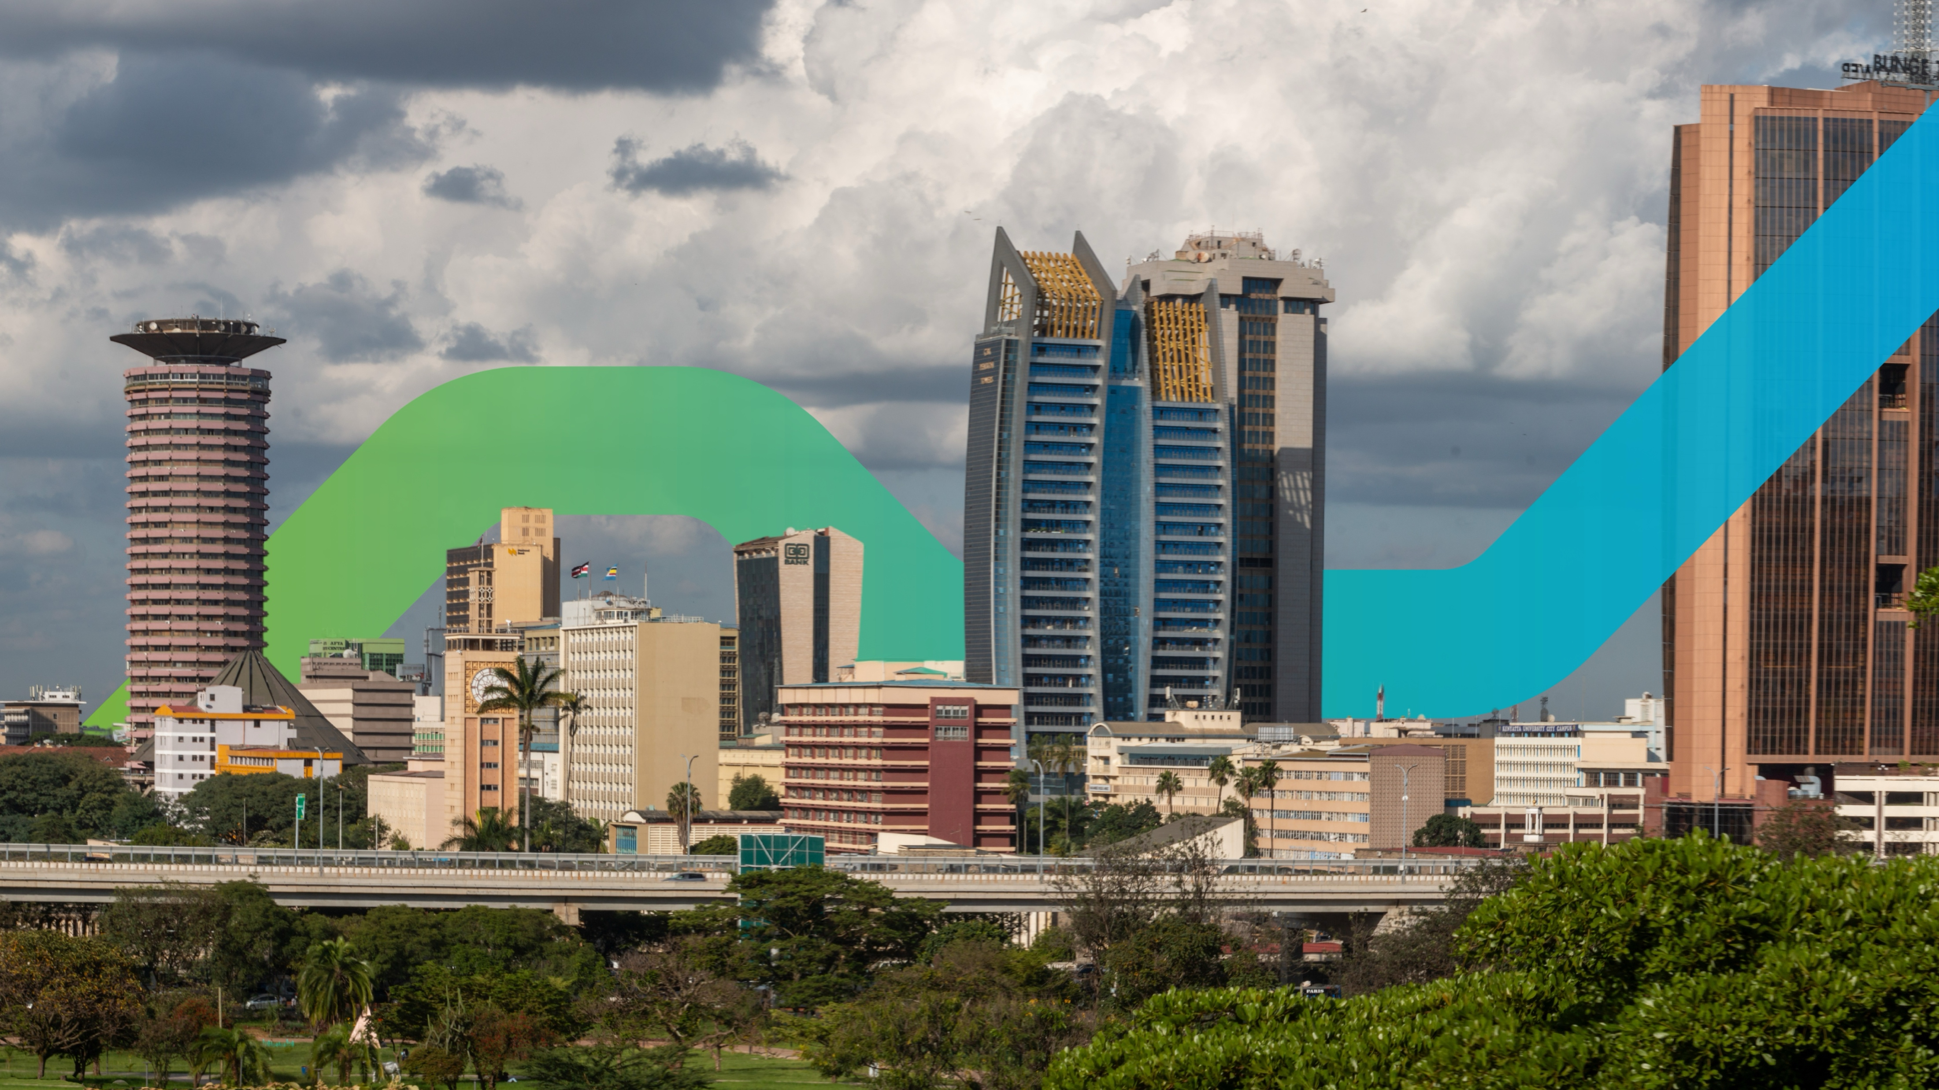

Local Currency Solution for Multilateral Development Bank Portfolio Transfer
JULY 2024
Dr. Evans Osano
Director, Capital Markets
Radisson Blu, Mosi-Oa-Tunya, Livingstone, Zambia
Friday, 26 July 2024

Slide 2
Outline
Background & Introduction
Preliminary Identification of MDB assets suitable for transfer (supply side)
Market sounding with institutional investors (demand side)
Fund Structure
Next Steps
(Supply side)

Slide 3
Background & Introduction
In June 2023, FSD Africa was selected by the MDB Challenge Fund to develop a “Local Currency Solution for Multilateral Development Bank Portfolio Transfer”.
Dual objectives of transferring parts of the MDB’s portfolios to local institutional investors in emerging markets.
Focuses on 7 countries in SSA.
1
  Free up capital
The project is undertaken in 2 phases:
Phase 1: Feasibility Study
Inception report presented at IMF-WB annual meetings in Marrakech
Feasibility study launch at the AfDB annual meetings in Nairobi.
Phase 2: Design of vehicle and piloting of transactions
EOI issued for qualified fund managers.
  allowing MDBs to expand the scope and size of investments and the pace with which they create project pipeline.
Transfer investment assets to local institutional investors
2
  Develop local capital markets
  Improve affordability for users/off-takers with local currency incomes

Slide 4
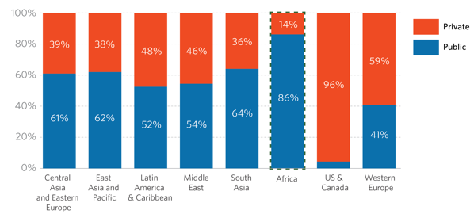
Climate Finance Challenge in Africa
Growth – to meet a need and an opportunity
How can we grow private sector share of climate finance from $4bn today to $100bn by 2030?
2030
64%
2019/20
86%
$177bn
Public sector
$100bn
African NDCs assume 90% of the funding is private sector & international
Private sector’s share of climate finance is only 14% (lowest among the regions).
$26bn
Private sector
Private sector
$4bn
14%
36%
$30bn
$277bn

Slide 5
Domestic pools of capital are growing and are expected to hit US$6.4 trillion in 2024
Offering a viable option for long-term financing
Source: The Blended Finance Taskforce

Slide 6
Allocations in alternative assets remain significantly lower than allowable limits
Clearly, investment regulations are not an impediment to diversification into alternative assets
Ghana’s 25% combines all alternative investments
Source: National pension investment guidelines and periodic investment reports.

Slide 7






Domestic institutional investors have shied away from alternatives, but why is that changing?
Increased sovereign risks
Higher “risk-free” interest rates driven by increased sovereign borrowing appetites.
Capital markets are undeveloped
An enabling regulatory environment
Alternative investment structures do not align with pension funds’ objectives
Growth in the size of pension assets has increased the appetite for additional risk

Slide 8
Preliminary Identification of MDB assets suitable for transfer
(Supply side)

Slide 9
MDBs have good quality assets that could be of interest
Default statistics recently released by the GEMs database for the last 28 years, shows that SSA has the highest recovery rates in projects funded by MDBs, against historical perceptions.
Geographic Region | All | Infrastructure | Financials | Other
East Asia and the Pacific | 69.7% | 65.0% | 62.9% | 71.9%
Europe and Central Asia | 72.5% | 79.1% | 73.8% | 70.8%
Latin America and the Caribbean | 71.7% | 73.1% | 65.4% | 72.8%
Middle East and North Africa | 82.5% | 87.9% | 82.6% | 81.4%
South Asia | 68.1% | 68.9% | 78.6% | 63.9%
Sub-Saharan Africa | 83.0% | 94.3% | 82.1% | 80.8%
N/A | 63.8% | 70.5% | 56.7% | 66.9%
Average | 74.7% | 78.7% | 74.1% | 73.9%

Slide 10
Assessment criteria used in arriving at the size of eligible assets
Countries: Kenya, Uganda, Tanzania, Senegal, Ivory Coast, Nigeria, Ghana
MDBs: IFC, AfDB, EIB, TDB, DBSA
Sovereign vs non-sovereign: Projects on private sector terms
Finance Type: Loans only
Sectors: All
Project End: Projects with a 3-year remaining maturity as of 2023
Across 7 countries that have relatively well-developed capital markets
Private sector assets yield a commercial rate of return
Loans with a minimum of 3 years remaining to maturity

Slide 11
Preliminary research findings and engagements with MDBs indicate an interest in recycling their portfolios
Additional projects will be eligible from TDB and DBSA, both keen on recycling their portfolios.
Discussions with TDB revealed that a large part of their sovereign lending is on commercial terms.
Proposed project solution is relevant to other DFIs and MDBs.
The eligibility of these projects depends on access to yet undisclosed information on the type of financing instrument, tenor, and maturity.

Slide 12
US$ 2.453 billion worth of IFC and AfDB projects are eligible for transfer
Assets in the real sector are worth more than FIs, but FIs assets have more disclosure.

Slide 13
Market sounding with institutional investors
(Demand side)

Slide 14
Fund managers engaged during market sounding are keen on a well-structured fund(s)
Fund managers engaged in the 7 countries have an average market share of 62% and manage US$ 36 billion in pension funds and CIS.

Slide 15
Institutional investor preferences is driven by a range of factors
Return Expectations: returns on transferred portfolios determined by local market circumstances
Composition of portfolio assets: institutional investors may be more drawn to ESG-compliant assets
Local Currency denomination: Strong preference for investments denominated in local currency.
Hard Currency – appetite for some hard currency exposure - but investment restrictions and availability of FX pose potential constraints.
Tenor & liquidity considerations: domestic investors can invest in relatively longer tenors – but stronger preference for liquidity in WAEMU and EAC
Regulatory Constraints: Limits to alternatives have grown but need to consider regional/offshore limits and investment process for alternatives
Sub-regional options: Where capital markets are more integrated (WAEMU and EAC) - portfolio transfer in a sub-regional fund is optimal.
Safety requirements - Credit enhancement, not required

Slide 16







Impressions from the institutional investors determine appetite and structure of the vehicle
NIGERIA
GHANA
WAEMU
KENYA
UGANDA
TANZANIA
Coverage of the vehicle
Africa-wide fund with sub-regional funds
Regional fund domiciled in Ghana
ECOWAS regional fund
East Africa
Fund
East Africa Fund domiciled in Uganda
East Africa Fund domiciled in Uganda
Currency
Both Naira and USD
Both Cedi and USD
CFA
EAC currencies and USD
EAC currencies and USD
Tanzania shillings
Tenor
Local Currency
5 years, but can extend to 15 years after proof of concept
10 years
10 years
>10 years
10 years
>20 years
US$
>10 years
10 years
N/A
5 years, afraid of unfamiliar territory
>10 years
N/A
Benchmark Return
FGN Bonds + spread of 0.25-1.5%
Ghana Govies
CFA Govies
Kenya Govies
Local Currency
>10%
US$
UST LT returns
UST LT returns
N/A
UST LT returns
N/A

Slide 17
Impressions from the institutional investors determine appetite and structure of the vehicle
NIGERIA
GHANA
WAEMU
KENYA
UGANDA
TANZANIA
Credit enhancement
Not required, a nice to have
Not required, a nice to have
Not required, a nice to have
Required
Required
Liquidity requirements
None. Contributions more than redemptions
None. Contributions more than redemptions
Required
Required
Required
Diversified with a higher allocation to infrastructure
Diversified with a higher allocation to infrastructure
Sectors
Diversified
Diversified
PFAs can invest in provided 60% is invested in Nigeria
Offshore investments up to a maximum of 5%
The regulator allow for 5-10% of the fund to be invested offshore
Offshore investments up to 15%
Investments in alternatives must obtain ministerial approval
Investments in alternatives must obtain BOT approval
Regulatory constraints
investments within EAC are treated as domestic

Slide 18
Pension funds have a large AUM that could be allocated to alternatives
Pension funds in the 7 countries could allocate up to US$8.7 billion to the portfolio transfer vehicle if the vehicle is locally domiciled.
Fund Size (Pension funds only)
 | $B | If Fund is locally domiciled (%) | If Fund is locally domiciled ($) | If Fund is externally domiciled (%) | If Fund is externally domiciled ($)
Kenya | 12.5 | 30% | 3.75 | 15% | 1.88
Nigeria | 12.7 | 20% | 2.54 | 20% | 2.54
Ghana | 2.7 | 15% | 0.41 | 5% | 0.14
Senegal | 1.08 | 10% | 0.11 | 10% | 0.11
CIV | 2.7 | 10% | 0.27 | 10% | 0.27
Uganda | 5.56 | 20% | 1.11 | 30% | 1.67
Tanzania | 5.06 | 10% | 0.51 | 0% | 0.00
Total | 42.30 |  | 8.69 |  | 6.60

Slide 19
Fund Structure
The fund will be a permanent or closed-end vehicle.
With an Africa-wide US dollars fund to transfer US dollar denominated assets.
Sub-regional funds will provide both local and hard currency financing within the limits of the investment regulations.

Slide 20
An African-wide US$ fund and local currency driven sub-funds will be optimal given regulatory limits on offshore investments
Investment regulations are more stringent on external investments but allow 10-30% in local domiciled alternative investment funds.
MDB Portfolio Transfer Fund Structure (Draft)
Investment Committee
Fund Manager
Investors
Umbrella Fund
Anchor Investors
FSDAi
DFIs
West Africa Sub-Funds
Africa Fund
East Africa Sub-Fund
WAEMU Sub-Fund
Other Investors
Pension Funds
Insurers
Investment Funds
Sovereign Funds
HNWIs
USD
KES
NGN
GHC
CFA
KE, UG, YZ, NG, GH, CI, SN portfolios
KE, UG, TZ portfolios
NG
portfolio
GH
portfolio
CI, SN portfolios
Guarantors
Key:
Flow of Fund Direction
Fund Type
Currency
Eligible Assets
Flow of Capital and Returns
Flow of Management Fees

Slide 21
The project builds on prior experiences where MDBs have leveraged on the private sector to mobilise finance
IFC’s Managed Co-Lending Program
Syndication allows investors to participate in private placements alongside IFC.
Syndications totaling $11 billion since 2013.
Investors benefit from IFC’s diversified portfolio of investments and First-loss coverage provided by SIDA.
AfDB’s Room-To-Run (R2R)
Securitized 45 well-performing brownfield, non-sovereign loans totaling $1 billion.
No single obligor >5% of transferred portfolio
AFDB retained first-loss tranche
Mezzanine tranche anchored by 2 investors
Senior tranche guaranteed by EU
AfDB maintained A- rating on senior tranche.
ILX private sector initiative
ILX co-invests with MDBs and DFIs.
75% in newly originated loans
25% are refinancing

Slide 22
Comparing the proposed structure to previous efforts
 | AFDB R2R | IFC Co-lending | ILX co-Investment | Proposed Structure
Structure | Synthetic securitization | Co-Investment | Participation (refinancing and co-investment) | Participation (refinancing and co-investment)
Guarantee | Provided by the EU | Provided by SIDA | Not required | Not required. Nice to have.
Assets targeted | Brown field | Predominantly brown field | Predominantly brown field | Predominantly brown field
Currency | Hard | Hard | Hard | Predominantly local
Investors | International | International | International | Domestic

Slide 23




In a systematic approach that ensures replicability of transactions on a critical mass
Transferring portfolios financing designated objectives, such as ESG or urban investments, to increase attractiveness to institutional investors.
Pooling assets across MDBs to create critical mass portfolios (within sub-regions).
Establish robust institutional structure to support an easily replicable process, moving from ‘one-off’ capital relief to ‘systemic’ capital relief.
A systematic approach that supports widespread adoption and replication.

Slide 24
Next steps
Launch of the feasibility study at the 2024 AfDB Annual Meeting
01
Post report engagement with MDBs, local institutional investors, regulators, and industry practitioners
02
Appointment of a fund manager to co-design and set up the fund
03
Pilot transactions
04

Slide 25
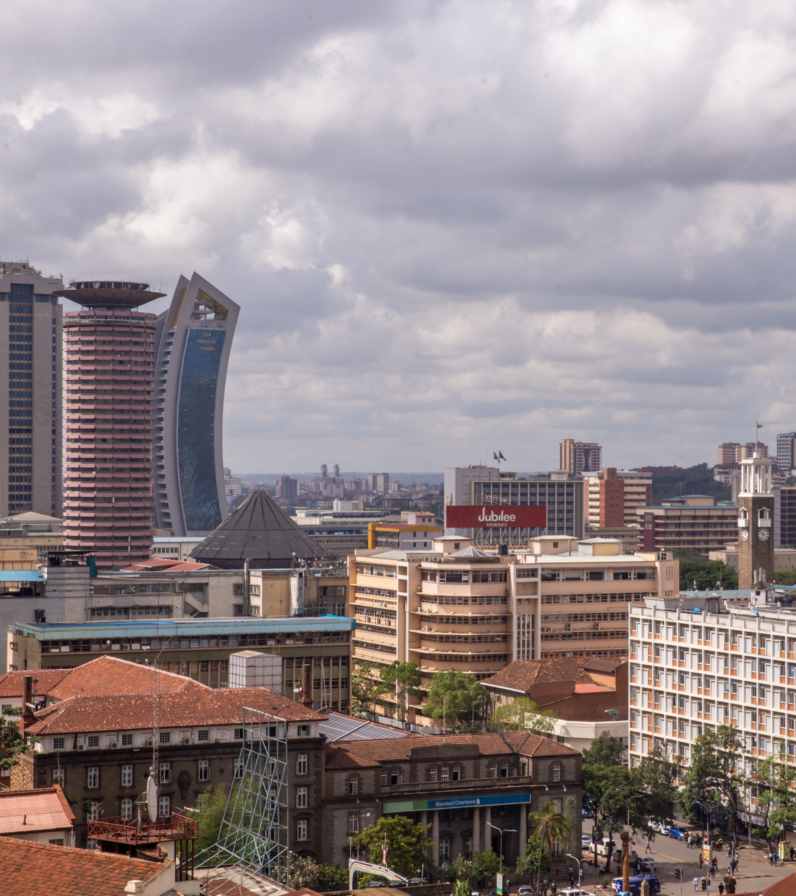
Thank You
FSD Africa contacts: evans@fsdafrica.org

Slide 26
MDBs are critical in this process
MDBs can play the following critical part in the portfolio transfer project:
1
2
3
4
MDBs have convening power, are highly rated and have preferred creditor status.
Avail portfolios for investment by institutional investors.
Information disclosure.
Provide portfolio transfer vehicles or other alternative mechanism.

